Slide 1
Diffraction Around a Barrier

Slide 2
By the end of this lesson, you should be able to:
Define the term diffraction.
Explain the relationship between diffraction and wavelength.

Slide 3

What is diffraction?
Imagine you are standing at the bottom of a hill. You hear the motor of a car approaching on the other side of the hill. You are hearing sound from the far side of the hill, which means, somehow the sound waves are making their way to your ears. The sound can’t travel through the hill, so what is happening?
In fact, the sound waves are bending around the hill! This is due to diffraction, which refers to the ability of waves to bend around a barrier. We observe this in day to day life with sound, but all waves—including water waves, seismic waves, and even light waves—will undergo diffraction.

Slide 4
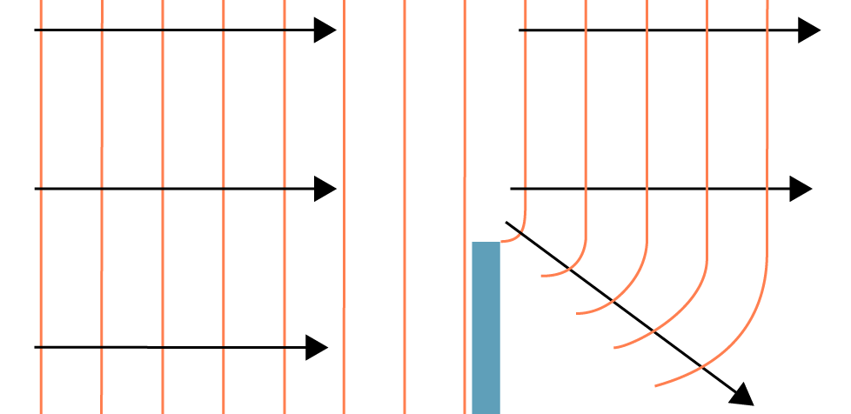
We call the ability of waves to bend around barriers diffraction.
We represent a travelling wave by drawing wavefronts. Wavefronts are imaginary lines that connect all points reached by a wave at the same time. The direction of wave propagation is at right angles to the wavefronts.
When these waves encounter a barrier, they undergo diffraction. We represent this by drawing new, curved wavefronts past the barrier, in the direction of the wave propagation. It is important to note that the wavelength of the diffracted wave is the same as before it undergoes diffraction.
However, since the diffracted wave is bent, the wave does not solely propagate in the same direction as earlier!

Slide 5

The direction of wave propagation has changed after diffraction.
This explains why, in the example at the start of the lesson, we can hear the noise from the car engine. The sound waves are diffracting around the barrier, and, because of their new direction of propagation, can now reach our ears.

Slide 6
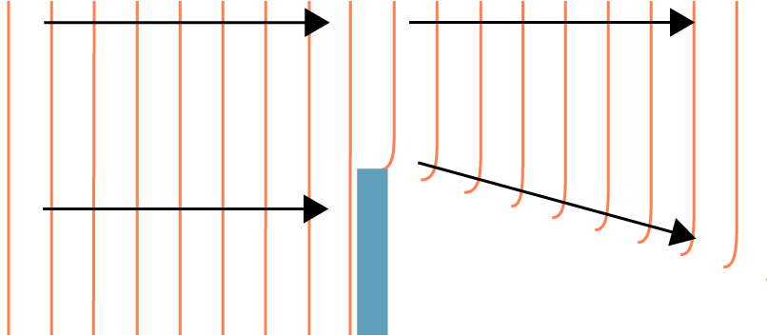
Some waves will diffract more than others.
In general, a wave with a larger wavelength will diffract more. We can see this on the two diagrams below.

Slide 7
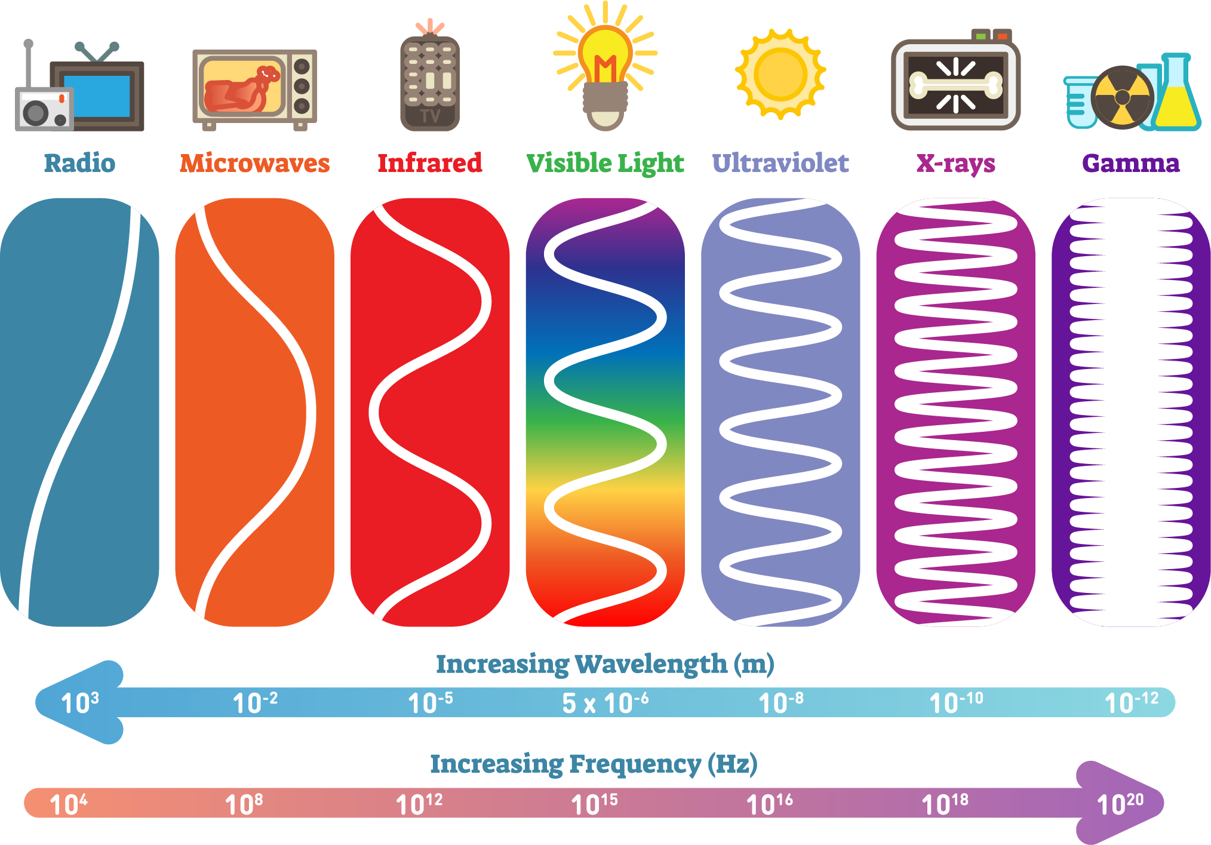
This is why we don’t see light undergo diffraction.
Sound waves that we can hear have wavelengths of between 17 centimetres and 17 metres. Most objects that we encounter are on this sort of scale, which is why sound diffracts.
However light waves have a wavelength of 400 to 700 nanometres. These wavelengths are approximately ten thousand times smaller than a millimetre. The objects in our day to day lives are simply too much larger than the wavelength of light to cause noticeable diffraction.

Slide 8
What about if a wave passes through a gap?
Well, we can think of a gap as being the separation between two barriers. Since we have seen that waves will bend around a barrier, we expect something similar to occur here.
In fact, the wave will bend around both sides of the gap, and fan out. The diffracted wave will retain the frequency, speed and wavelength from before it underwent diffraction, however, as before, the direction of propagation has changed.

Slide 9
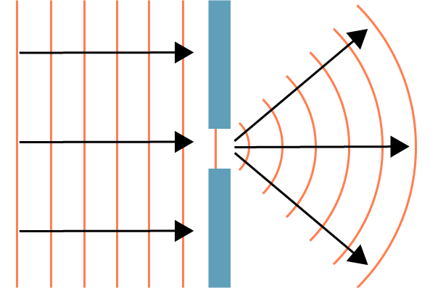
How does the size of the wavelength affect the amount of diffraction through a gap?
We saw earlier that a larger wavelength will diffract more than a shorter wavelength when encountering a barrier. This is similar to what happens when a wave passes through a gap, but there are some differences.
When a wave passes through a gap, maximal diffraction will occur when the size of the wavelength is approximately equal to the width of the gap. Waves with a wavelength shorter than this will diffract less.
If the wavelength is many times larger than the width of the gap, the wave will not pass through easily. This will not be covered in much detail in this lesson.

Slide 10
A typical speaker has a gap in the front which allows sound waves to escape.
If you stand in front of a speaker, you will hear both the high and low pitched sounds. However, if you walk to one side, you will stop hearing the high pitched sounds, while still hearing the lower sounds.
Evidently, there is some diffraction occuring, but different sounds are diffracting different amounts. How do you think we can explain this?

Slide 11
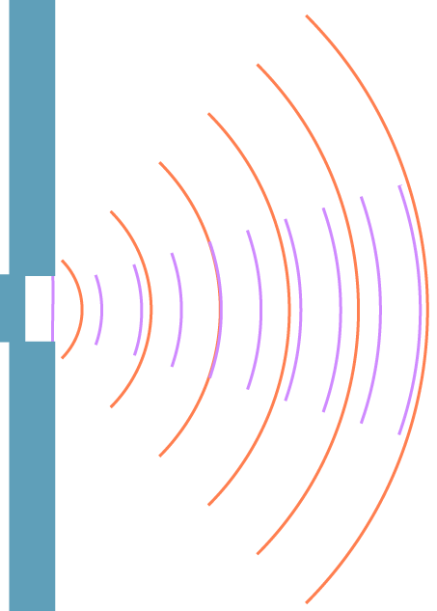
This is because the sound waves diffract through the gap.
Lower sounds have lower frequencies, and therefore longer wavelengths than higher sounds. Since the lower sounds have longer wavelengths—closer to the size of the gap—they will diffract more.
Conversely, the higher sounds have higher frequencies and therefore shorter wavelengths. This means they diffract less, and do not spread out as far.

Slide 12
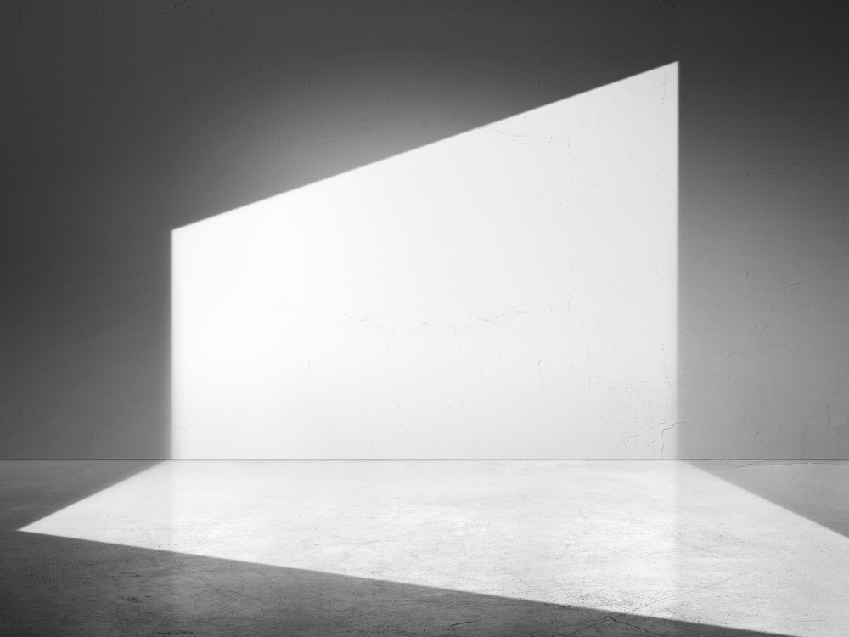
This explains why sound will diffract through a doorway, but light won’t.
Imagine a guitarist in a room playing music. You are standing to the left of the door, and cannot see the guitarist. However, you can hear the music she is playing.
This is because the sound waves have wavelengths relatively close to the size of the door (which acts like a gap). These waves diffract sharply, and reach your ears. The light waves have wavelengths much smaller than the size of the door though, and do not undergo diffraction. This results in sharp shadows being formed on the ground.

